Slide 1
Product & Client Research
Yan Qin

Slide 2
Overview
About the Research
Background
Objective
Methodology
1st Model
2nd Model

Slide 3
About the Research
Background
A pharma entity conducted some research on their main products and clients during a certain period. Around 16,000 of their clients were selected during the research period.
The pharma industry is currently heavily focused on the Leishmaniasis disease and ensuring drugs get to market via their customers in an effective and efficient manner.
Objective
Create customers’ profile to make the pharma entity aware of its typical customer selling their products in markets successfully.
Develop models that will allow the company to use the results to target new and similar customers in future.

Slide 4
Methodology
1st model: estimate the probability of customers who responded to the research
Implement a logistic regression model to classify if a customer purchased drugs during the research period.
2nd model: estimate the size ($) of the transaction
Implement decision tree, random forest, and Xgboost models to estimate the purchase amount ($) for each customer.

Slide 5
1st Model

Slide 6
Data Exploration
This dataset has 18 input variables (information) from 16173 records (customers).
Input variables are:
Customer Number, Purchase amount during research period, Historical Sales Volume, Date of First Purchase, Number of Prior Year Transactions, External Agent, Repurchase Method, Last Transaction Channel, Miltefosine, Ambisome, Pentamidine, benznidazole, nifurtimox, dapsone, streptomycin, Malarone, Ribavirin, Ship to country

Slide 7
Data Exploration
Remove records that contain NaNs, blank entries, negative purchase amount or sales volume.
Create a new feature called ‘Number of Years Being Customer’ from ‘Date of First Purchase’.
Drop columns of ID, ‘Date of First Purchase’ and drugs that cannot treat Leishmaniasis disease.
Create a predict variable called ‘Purchase’ from ‘Purchase amount during research period’. If ‘Purchase amount during research period’ is greater than 0, ‘Purchase’ = 1, otherwise 0.

Slide 8
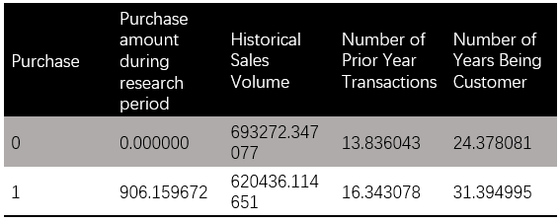
Data Exploration
The average number of purchase amount for customers who purchased drugs during the research period is $ 906.
The average Historical Sales Volume from the customers who purchased drugs during the research period is lower than that from the customers who didn't. (but no big difference; class is imbalanced, not enough customers from purchased group.)
The average number of prior year transactions the pharma entity had with the customers who purchased drugs during the research period is higher than that from the customers who didn't.
Customers who purchased drugs during the research period has longer years of being customers with the pharma entity than customers who didn't.

Slide 9
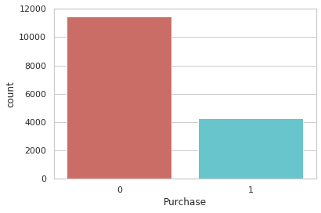
Data Visualization
Percentage of no purchase is 72.79;
Percentage of purchase 27.20.
We have imbalanced data where minority class is ‘Purchase’ = 1, majority class is ‘Purchase’ = 0.

Slide 10
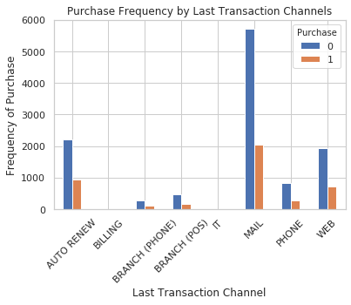
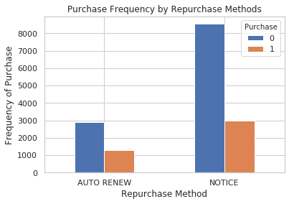
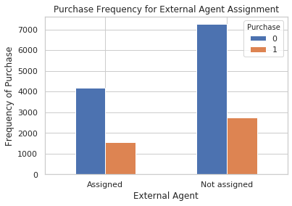
Data Visualization
Last Transaction Channel, Repurchase Methods, and External Agent can be used to predict the class of ‘Purchase’.

Slide 11
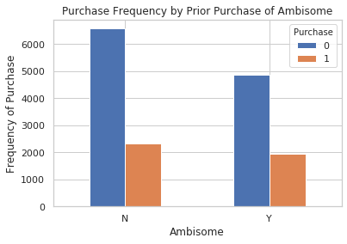
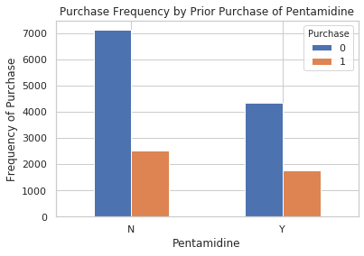
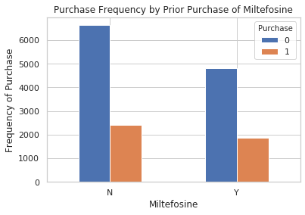
Data Visualization
Three drugs (from the dataset) that can treat Leishmaniasis are Abisome, Pentamidine, and Miltefosine. They can be used to predict the class of ‘Purchase’.

Slide 12
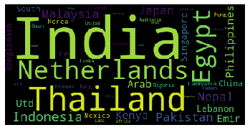
Data Visualization
Majority of the customers sold drugs purchased from this pharma entity to India, Thailand, Netherlands, Egypt, Philippines, Malaysia, Nepal, Indonesia, and Pakistan.

Slide 13
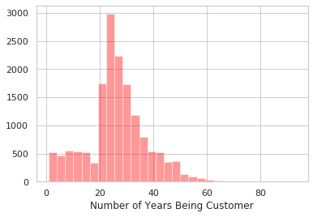
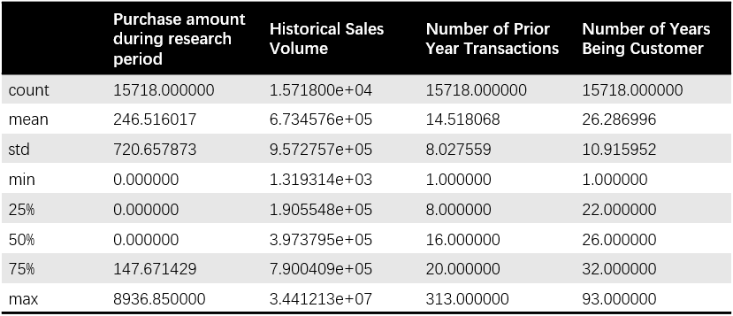
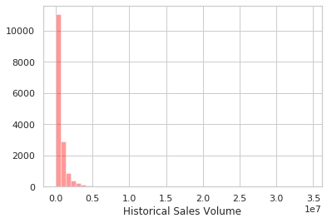
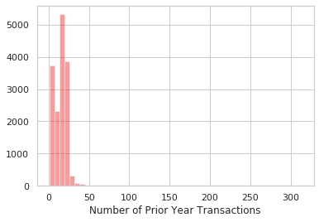
Data Visualization

Slide 14
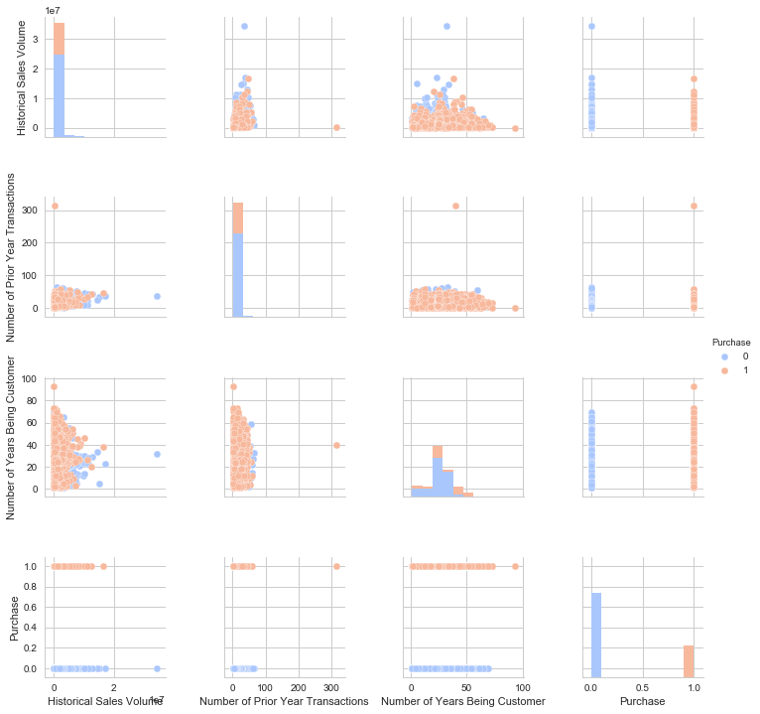
Data Visualization
Information of past transaction, sales volumes, years of being customer are quite different between Customers have ‘Purchase’ = 0 and Customers have ‘Purchase’ = 1.

Slide 15
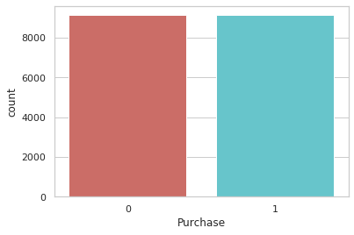
Imbalanced Classes – Create Synthetic Samples
Randomly select 80% of the data as training data, the rest are test data.
Since the data has imbalanced classes, SMOTENC (an extension of SMOTE as the data has a mix of categorical variables and continuous variables) is adopted to create synthetic samples from minority class, in this case, ‘Purchase’ = 1.
Apply SMOTENC technique on training data only.
Oversampled data has 18274 rows.
Number of no purchase in oversampled data 9137
Number of purchase 9137
Classes are balanced.

Slide 16
Feature Selection
Create dummies for the categorical variables in the data.
66 variables in the feature space.
Apply Recursive feature elimination technique to reduce feature space. It is a feature selection method that fits a model and removes the weakest feature (or features) recursively.
33 features remain in the space.

Slide 17
Model Implementation
Apply logistic regression model on training data.
Values of parameters of the fitted model are:
C=1.0, class_weight=None, dual=False, fit_intercept=True, intercept_scaling=1, l1_ratio=None, max_iter=100, multi_class='auto', n_jobs=None, penalty='l2’, random_state=None, solver='liblinear', tol=0.0001, verbose=0, warm_start=False

Slide 18
Model Result
Confusion Matrix
High recall (83.91%), low precision (27.47%) indicates that most of the positive examples (‘Purchase’ = 1) are correctly classified (low false negatives) but there are a lot of false positives.
 | Predicted: 0 | Predicted: 1
Actual: 0 | TN = 446 | FP = 1859
Actual: 1 | FN = 135 | TP = 704

Slide 19
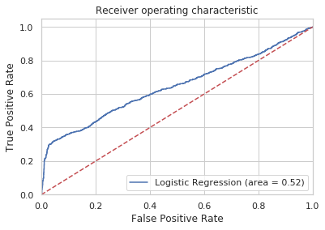
Model Result
ROC Curve
Even thought the accuracy score isn’t high, the ROC curve of this model is away from the dotted 45-degree line.

Slide 20
2nd Model

Slide 21
Model Result
“Purchase amount during research period” is the predicted variable.
Random Forest outperforms others with smaller RMSE = 702.9.
 | Decision Tree | Random Forest | Xgboost
RMSE | 715.3 | 702.9 | 709.9

Slide 22
Conclusion
A logistic regression model can predict if a customer purchase/ will purchase the drugs from the entity or not using their past transaction records, historical sales volume, number of years being customer, external agent assignment, repurchase method, past transaction channel, and the countries they used to sell the drugs to.
Random Forest model is then adopted to predict the purchase amount each client made/ will make from the pharma entity.
More information of clients who purchased drugs can be collected in the future to balance the classes.
Future work: create 4 types of client profiles based on the drugs they purchased in the past.
1. Clients who purchased at least one type of drugs that can treat Leishmaniasis disease and at least one type of other drugs.
2. Clients who purchased at least one type of drugs that can treat Leishmaniasis disease and no other drugs.
3. Clients who purchased no drugs that can treat Leishmaniasis disease and at least one other types of drugs.
4. Clients who didn’t purchase any drugs prior to the research period.

Slide 23
Appendix
Code:
https://colab.research.google.com/drive/1jlzPVjWd33wJTCwTlA4h8ATa61SZ3fj4
https://colab.research.google.com/drive/1R1xVlUGS-w_1TKhmEPUZtZZzlresFRyy

